Slide 1




Slide 2
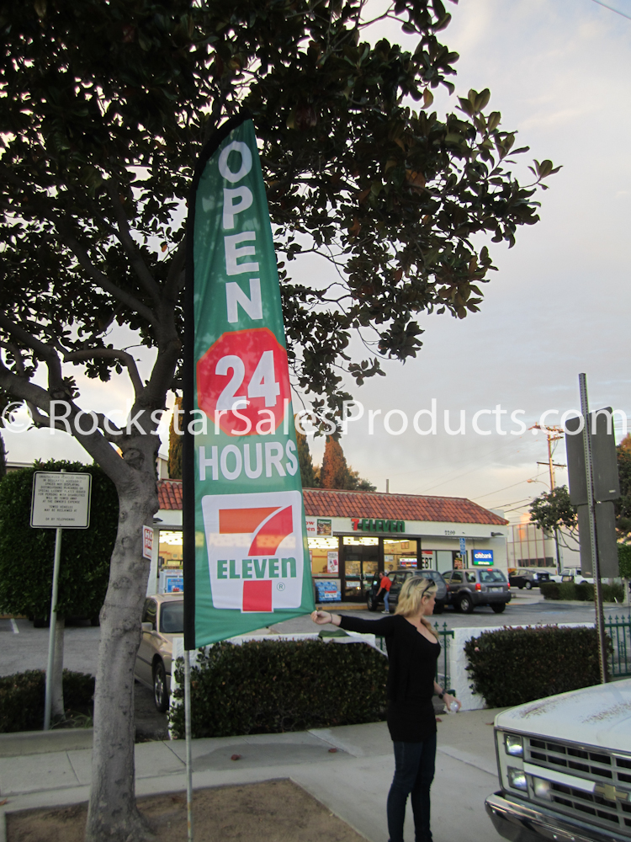
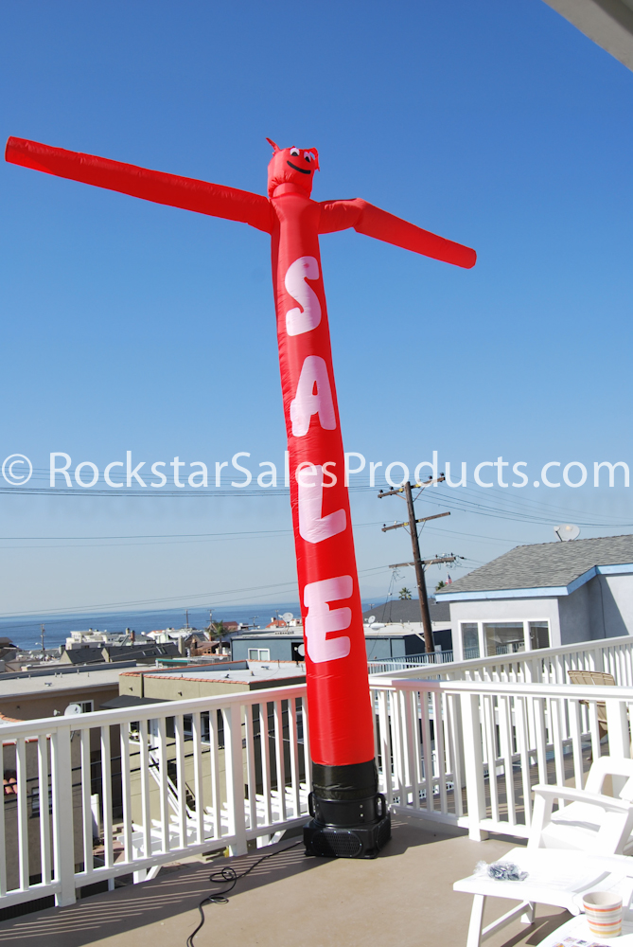
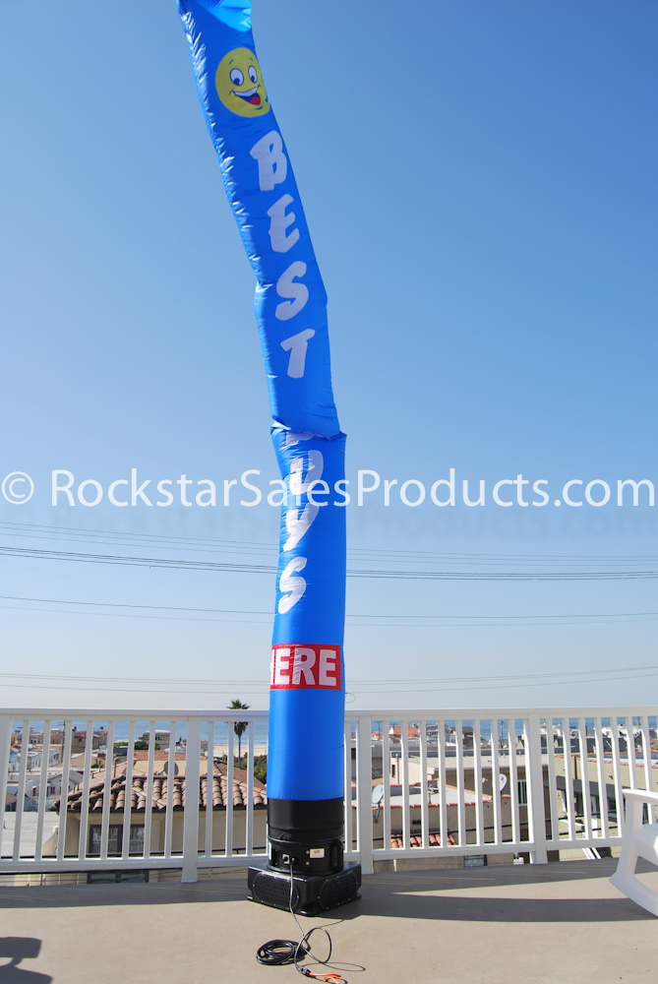
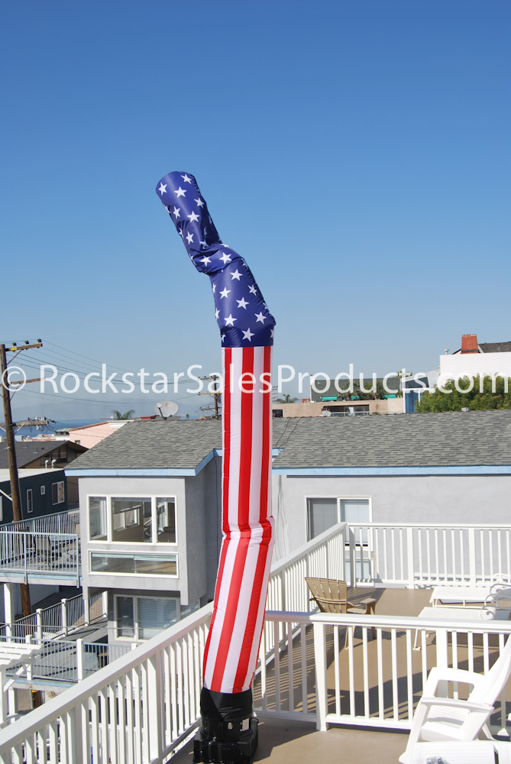
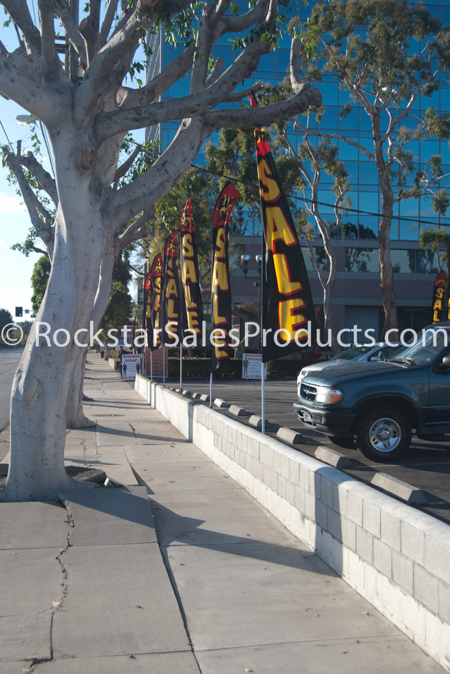
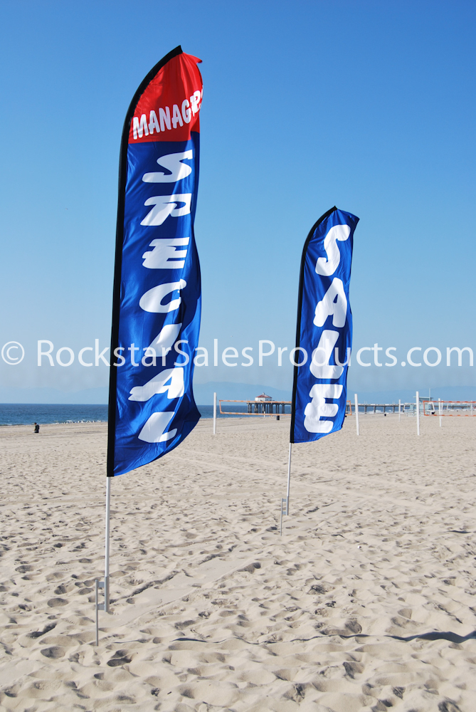
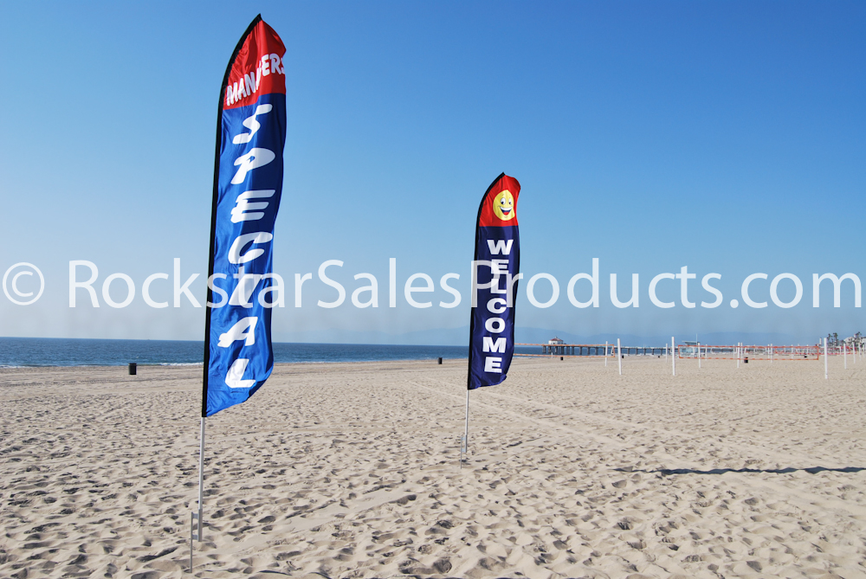
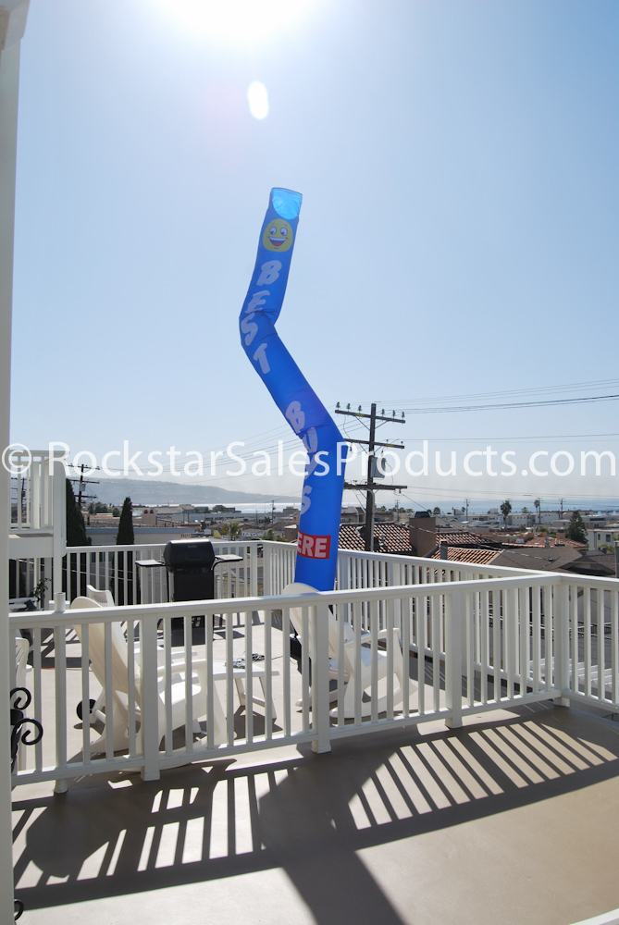
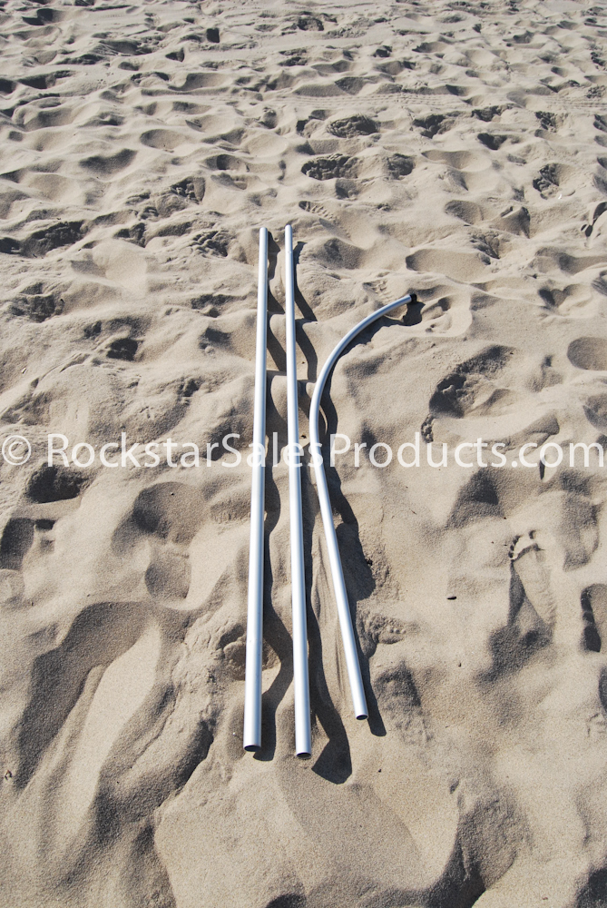
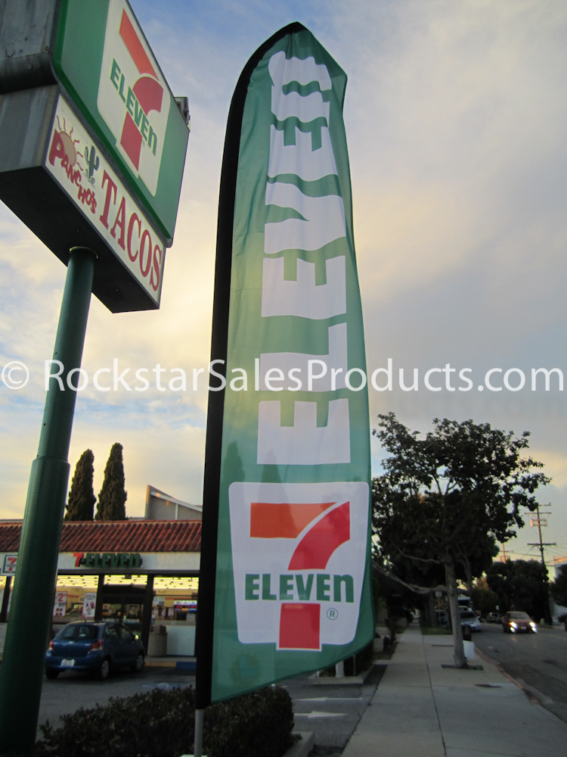
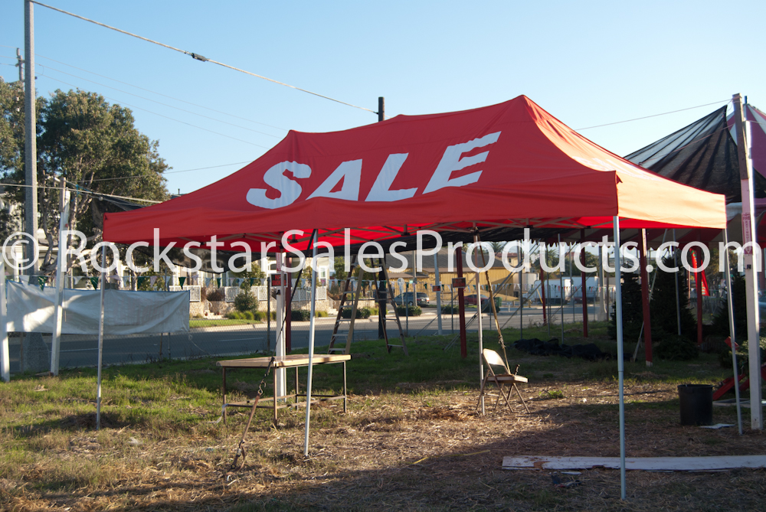
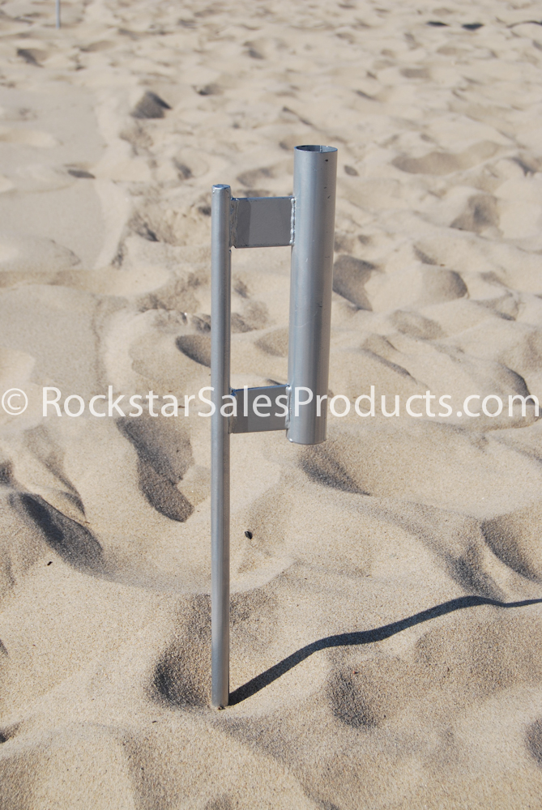
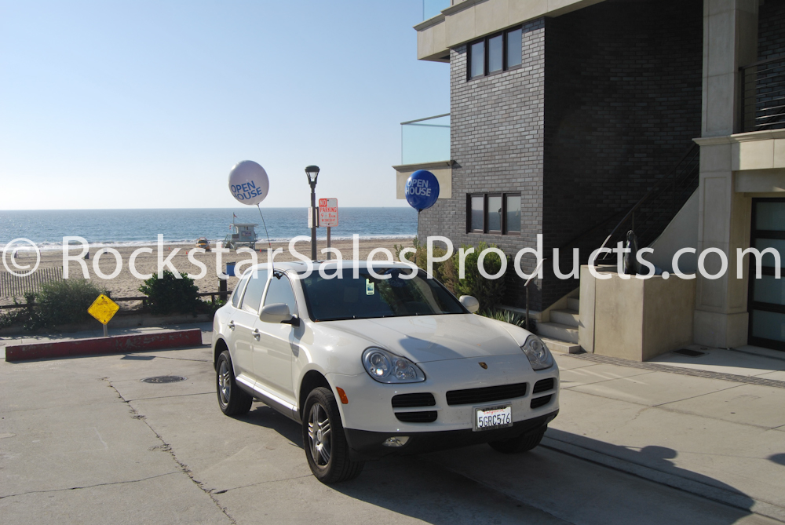
OUR TOP PRODUCTS
SWOOPER FLAGS
GIANT INFLATABLES
TENTS
BALLOONS

Slide 3


888•675•9610
CONTACT US
www.RockstarSalesProducts.com
info@RockstarSalesProducts.com
www.facebook.com/RockstarSalesProducts
www.twitter.com/RockstarSP

Slide 4
Rockstar Sales Products is a manufacturer of sales products. We are seeking distributors in other regions to represent our quality brand of products that assist businesses by increasing their exposure - Increasing their profits.
We are the leading manufacturer of sales products in the United States, Canada, Australia, New Zealand and England. Our brand is known for quality and durability. With this strong brand behind you, you can trust our brand to best fit the needs of your customers.
WHY WOULD YOU BECOME A DISTRIBUTOR?
• Help Businesses Increase Their Profits
• Create Immediate Sales & Income
• We Stock over One Million Sales Products
• We Are the Manufacturers, SO…Your Wholesale Price is the BEST – AND You Will Successfully Sell Against Your Competition
• We Are Family Owned & Manufacturing Since 1959
• We offer only the BEST quality for the BEST price!
Email or call us today to hear more about this incredible opportunity!
info@rockstarsalesproducts.com
See more about our products at:
http://www.rockstarsalesproducts.com
http://www.facebook.com/rockstarsalesproducts.com
http://www.twitter.com/rockstarsp
http://www.linkedin.com/company/rockstar-sales-products
Call us at:
888•675•9610

Slide 5
We manufacture sales products proven to increase visibility to your business, bringing new customers in and increasing your revenue! Think of your top competitors...they use outside sales products - WHY? Because they work!
Using products such as flags, banners and giant inflatables show that you are more “put together” and set you apart from your competition.
Our clients find that the cost of flags are the cheapest form of advertising (especially on busy streets) than all others and this investment will last for years to come. With thousands of potential patrons driving by your business daily, this tells us that they live or commute near your business. Flags along the road allow a driver to see your business - without turning their head while driving, not to mention other constant distractions drivers have.
How many new customers would it take to see a profit from this 1 to 2 year investment? Probably not too many. Usually less than 5.

Slide 6
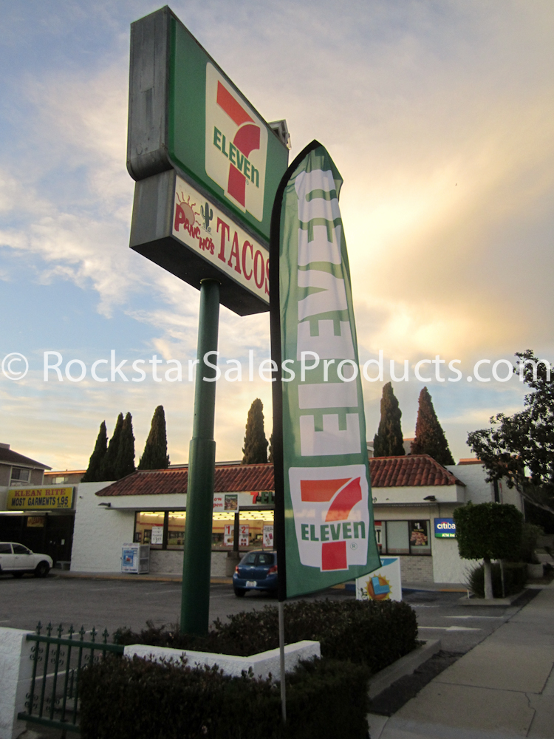
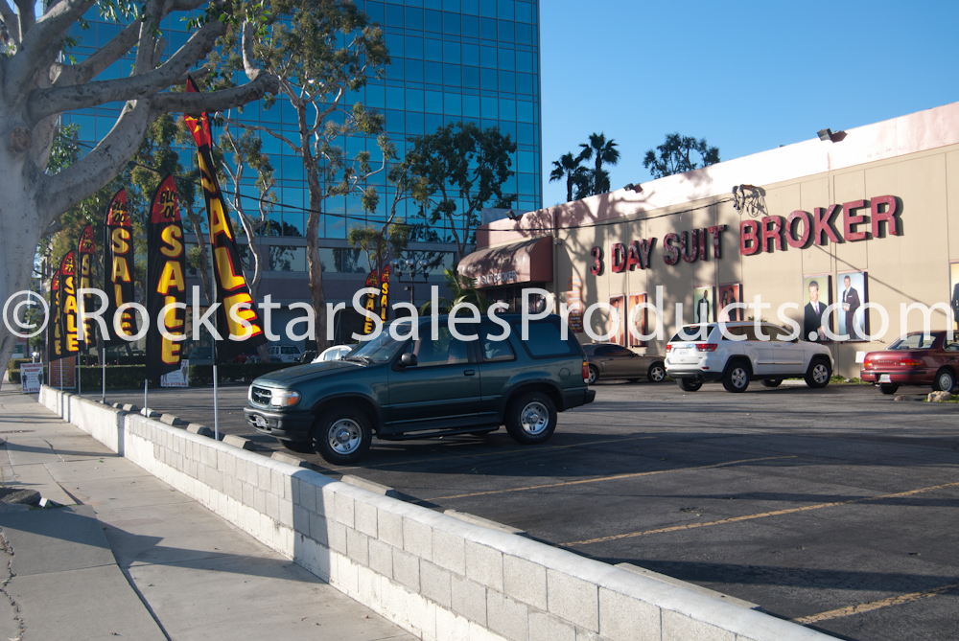
OUR TOP PRODUCTS

